Slide 1
Welcome to the 2nd annual State of Scottish Democracy lecture
To stay in the loop about our work in Dunfermline sign up at
tinyurl.com/dunfermline23

Slide 2
Electoral Reform Society’s State of Scottish Democracy Lecture
Lesley Riddoch
@lesleyriddoch
www.lesleyriddoch.com

Slide 3
‘communities need control over decisions that affect their lives.’

Slide 4
Amen
But Scotland has Europe’s weakest local democracy thanks to massive country-sized councils…
… and also its strongest local democracy thanks to 350 volunteer-led, unfunded, buyout communities.
SO WHICH ARE WE TALKING ABOUT?

Slide 5
Scotland’s formal system of local government?

Slide 7
So community trusts have developed to fill the local void

Slide 8
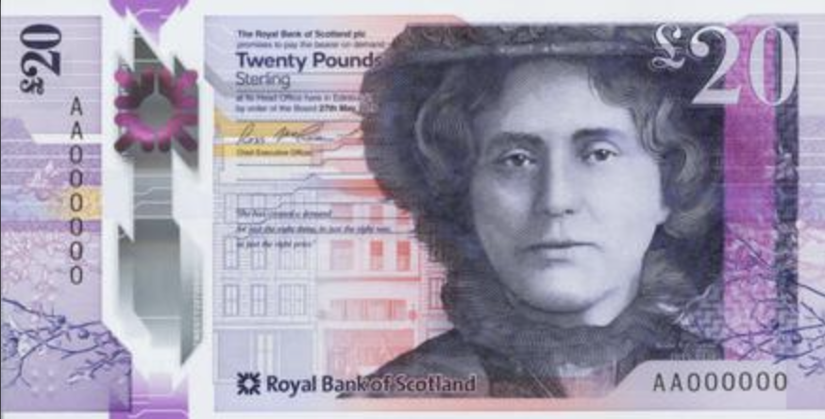
Will Democracy Matters square this Scottish paradox?
Or ignore the problems with formal local democracy
…. load more powers and responsibilities onto some valiant, over-stretched communities (but not others)
….. and leave our massive ‘regional’ councils intact?

Slide 9
How did we get here?
In 1973, 400 councils were cut to 53 district and 9 regional authorities by Ted Heath.
In 1996, 62 councils were cut to 32 single-tier authorities by John Major.
This Tory centralisation was not imposed on England where 10,480 parish and burgh councils have annual budgets of £1m, dwarfing Scotland’s 1,200 community councils on £400 apiece.

Slide 10
There have been critiques …. in 2010
Notes:
Paddy Bort, Robin McAlpine and Gordon Morgan 2012

Slide 11
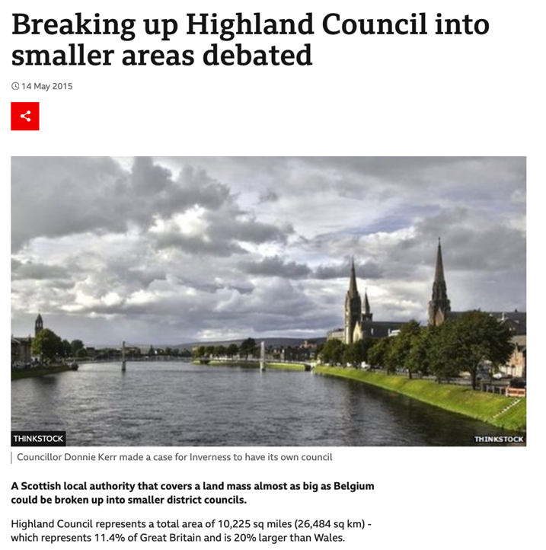
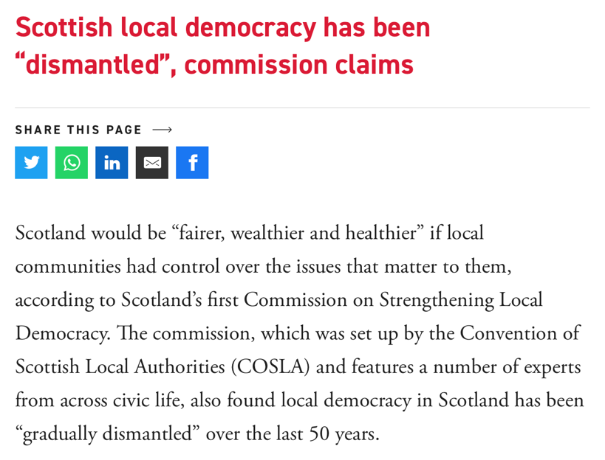
…. and in 2013

Slide 12
So local democracy in Scotland is at a crossroads

Slide 13
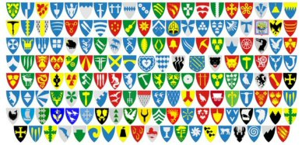
COMMUNITY
NORWAY
SCOTLAND
COMMUNITY
MEANS
MUNICIPALITY
COMMUNITY
MEANS
VOLUNTEERS

Slide 14
Capable people generally govern themselves
Scotland
32
11
Norway
400

Slide 15
But Scotland’s communities have had to prove themselves worthy first.
One by one.
Over quarter of a century.

Slide 16
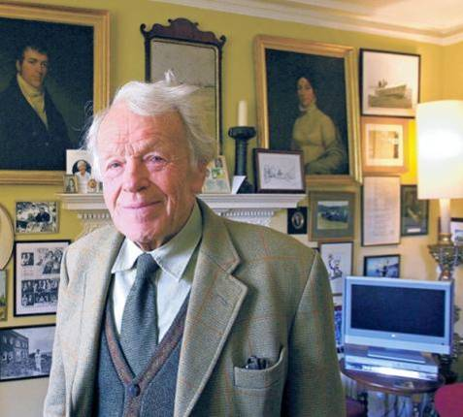
LIKE EIGG

Slide 17
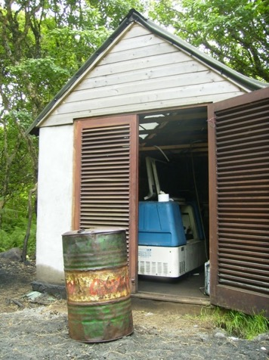
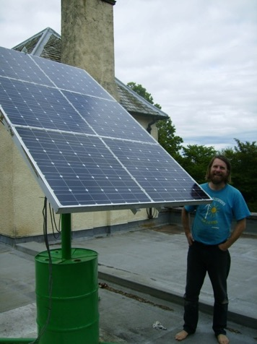
before …......

Slide 18
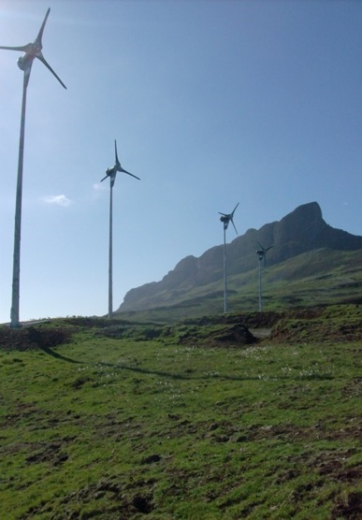
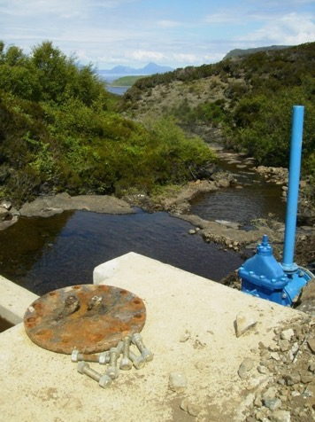
AND AFTER

Slide 19
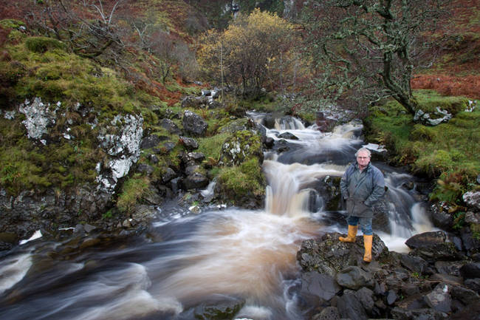

Slide 20
Eigg miracle; 2 bed for £40k

Slide 21
Self building with NATIVE WOOD

Slide 22
…and NATIVE TALENT

Slide 23
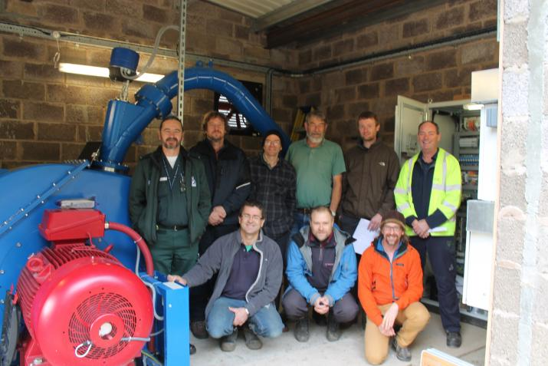
Strontian – Community Energy

Slide 24
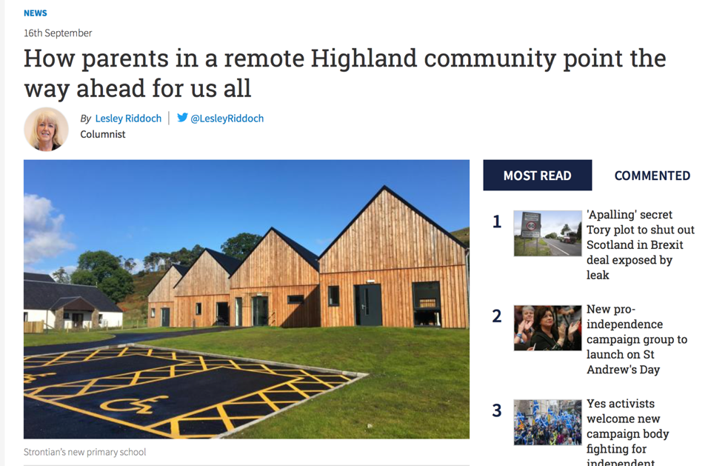
Sunart primary Plan

Slide 25
Incredible stories – but elsewhere truly local councils do the heavy lifting

Slide 26
Take the Faroes – 55k people/ 30 councils

Slide 31
Built by Vagur council for quarter price

Slide 32
Creating local jobs ….

Slide 33
Using local volunteer labour ….

Slide 34
…. creating local pride
Notes:
More - Páls Høll (Paul’s Hall) opened in 2015 and prompted this former fishing community to create ‘an experience economy’ with such positive memories of childhood that departing youngsters would return to start families. It’s worked. The population is rising after 70 years of steady decline and there’s now a new multi-sports hall, a Sports High School and 485% more visitor accommodation to cope with the influx of young sportspeople, families and tourists.
According to former mayor Dennis Holm; ‘the more remote you are, the more power you need locally’.

Slide 35
So why not here?
Fears of unaffordability based on current pay grades & bureaucracy
Fears of local favoritism & corruption
Fears of apathy and lack of local capacity.
City-based professionals who don’t get out enough and won’t reflect on the topdown structures and elitist presumptions that riddle British and Scottish democracy.
Notes:
Councils get 20% of income tax in a fixed formula. 88% turnout at elections.

Slide 36
So communities or councils?
It may seem simpler and cheaper to forget the mess that is formal local democracy and concentrate on feisty community groups instead. After all these highly motivated local volunteers care enough to run the vital assets councils, churches, quangos, lairds and charities have left behind.
BUT Development Trust volunteers must grapple daily with rules and regulations that occupy armies of highly paid professionals in every formal wing of government. They cannot take on more powers or budgets without dependable core funding to pay local directors.
If more planning and budgetary powers are devolved to (some) communities, membership-led trusts will turn into mini-councils & feel obliged to tackle every local problem without statutory powers, dependable long-term funding or the democratic validation of community-wide elections.
So here’s a revolutionary thought – why not do both?
Like every mature democracy around us.

Slide 37
Especially Norway
Norway’s small councils double & treble up portfolios,
Cooperate with neighbours
Hire Education Directors who are also part-time teachers.
Pay normal salaries
Home lies a walk not two day’s drive away, so council meetings are held in the evenings, day-jobs continue and councillors aren’t paid.
Poorer councils are supported by central transfers and very small councils cooperate with neighbours - something private outsourcing companies and large ‘monopoly’ councils find hard.
Higher participation with 12k councillors in Norway v 1.2k councillors in Scotland.

Slide 38
So if Democracy really Matters….let’s consult the best

Slide 39
Thank you for attending the 2nd annual State of Scottish Democracy lecture
To stay in the loop about our work in Dunfermline sign up at
tinyurl.com/dunfermline23

